Slide 1
Nursing Home Tabletop Exercise
Date
Time

Slide 2
Why are we here?
Regulation 42cfr483.73 applies to Medicare & Medicaid participating providers
Emergency Care: states:
Emergency Preparedness & Procedure Initial Training
Provide Emergency Preparedness Training Annual
Conduct an exercise annually
Full scale exercise
Can conduct a second exercise in that year
Full Scale or Tabletop

Slide 3
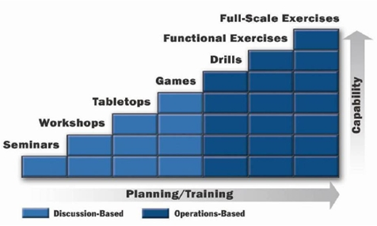
Normally
Typically, 3-5 yrs before first Full Scale exercise
Normal Progression:
Training seminars
3-4 Tabletop exercise
Functional exercise
Full Scale exercise
Conduct a Full Scale Exercise by Nov 1

Slide 4
What you should expect
We will present you with a scenario.
Tabletop exercises are discussion based.
Hold discussions
Refer to procedures
Make phone calls
Ask questions of Management

Slide 5
Evaluation
You do not receive a grade for your actions
It is NOT Pass/Fail
We are looking at:
How well you follow your procedures
How effective are your procedures
Area that might need improvement

Slide 6
Today's exercise rules
In any exercise a number of assumptions and artificialities may be necessary to complete play in the time allotted. During this exercise, the following apply:
The scenario is plausible, and events occur as they are presented
There are no “hidden agendas” or trick questions
All players receive information at the same time
The exercise will be conducted in a no-fault learning environment in which systems and processes, not individuals, will be evaluated.

Slide 7
Exercise
6 Modules

Slide 8
Exercise Objectives
Explain the Nursing Home’s emergency organizational structure which is capable of 24x7 operations.
Explain how the Nursing home will communicate with staff members and with other emergency response entities during an emergency.
Provide life-sustaining services including hydration, feeding, sheltering temporary, housing evacuee support, reunification, and distribution of emergency supplies.

Slide 9
Questions

Slide 10
Let’s Begin

Slide 11
Module 1 NWS Terminology Watch vs. Warning
Watch
Warning
A watch means conditions are right for dangerous weather. In other words, a "watch" means watch out for what the weather could do, be ready to act.
When a severe thunderstorm, tornado or flash flood watch is in effect, it means you should watch the sky for signs of dangerous weather
A warning means that the dangerous weather is threatening the area.
For severe thunderstorms, tornadoes and flash floods, a warning means the event is occurring.

Slide 12
Module 2 Severe Thunderstorm Watch
September 6, at 1:30 pm. The National Weather Service issues a Severe Thunderstorm Watch for all of Eastern LaSalle County, Grundy County, Will County, Southern Cook County, and Northern Kankakee County. Severe Weather with heavy rain and high gusty winds up to 55 mph have been reported in Seneca heading NORTHEAST at 20 mph.
The Severe Thunderstorm should be at :
Morris 2:00 PM
Channahon 2:30 PM
Ingalls Park 3:03 PM
Orland Park 3:40 PM

Slide 13
Module 2 Questions
How would you be made aware of the warning?
What are your thoughts at this time?
Are there any actions you would take?
What does your procedure say you should do at this point?

Slide 14
Module 3 Morris Warning
At 1:52 PM, the National Weather Service issues a Severe Thunderstorm Warning for Eastern LaSalle County, Grundy County, Will County, Southern Cook County, and Northern Kankakee County. Severe Weather with heavy rain and high gusty winds up to 55 mph have been reported in near 3 miles West of Morris heading NORTHEAST at 20 mph. Rotation can be seen in the he Severe Thunderstorm.
The Severe Thunderstorm should be at :
Morris 2:00 PM
Channahon 2:30 PM
Ingalls Park 3:03 PM
Orland Park 3:40 PM

Slide 15
Module 3 Questions
What are your thoughts at this time?
Are there any actions you would take?
What does your procedure say you should do at this point?

Slide 16
Module 4 Channahon Touchdown
At 2:22 PM the National Weather Service issues a Tornado warning for all of Grundy County, Will County, Southern Cook County, and Northern Kankakee County. A tornado was spotted by a trained spotter 3 miles West of Channahon heading NORTHEAST at 20 mph. The Tornado has caused damage and is extremely dangerous and has generated hail.
The Severe Thunderstorm should be at :
Channahon 2:28 PM
Ingalls Park 3:01 PM
Orland Park 3:42 PM

Slide 17
Module 4 Questions
What are your thoughts at this time?
Are there any actions you would take?
What does your procedure say you should do at this point?

Slide 18
Module 5 It’s Here!
At 2:57, a visitor enters the building and comments on how green the sky is and the wind is picking up. Within just a few minutes, the Tornado hits the building.
Only the top floor shows any signs of damage. The lower floor is complete intact.
12 Residence rooms have minor damage at the very Northwest corner of XX Avenue.
The affected area has broken windows and some water damage.
Electrical Power and Natural Gas is still being supplied.

Slide 19
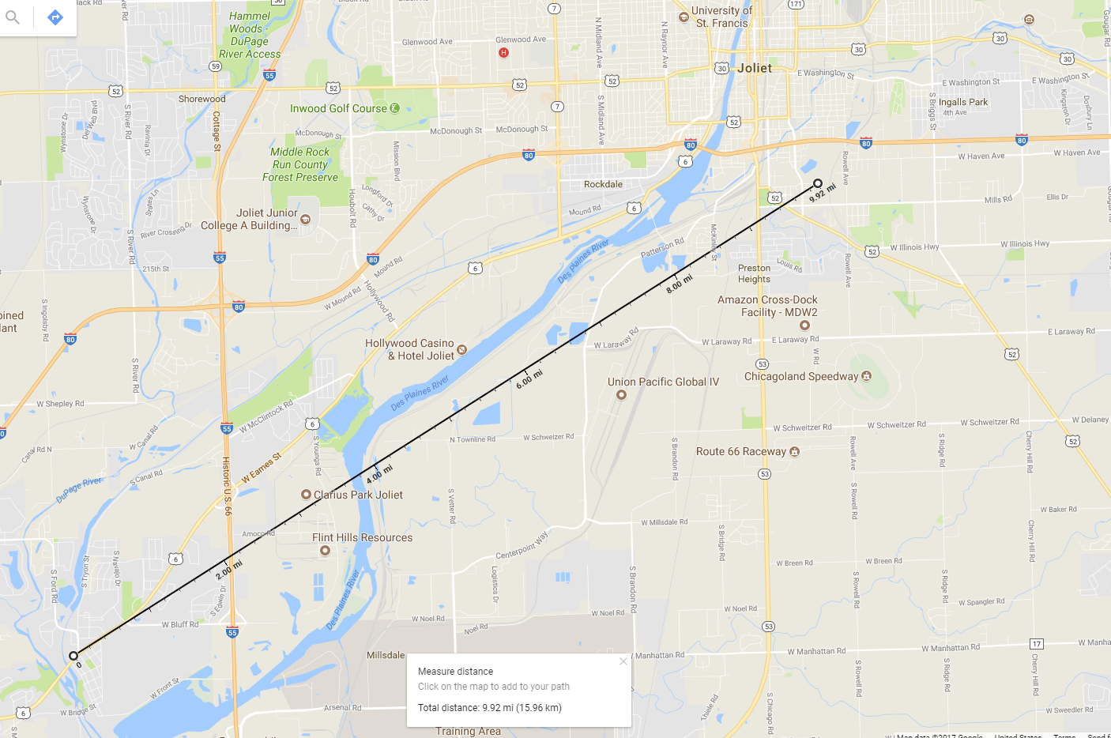
Storm Path

Slide 20
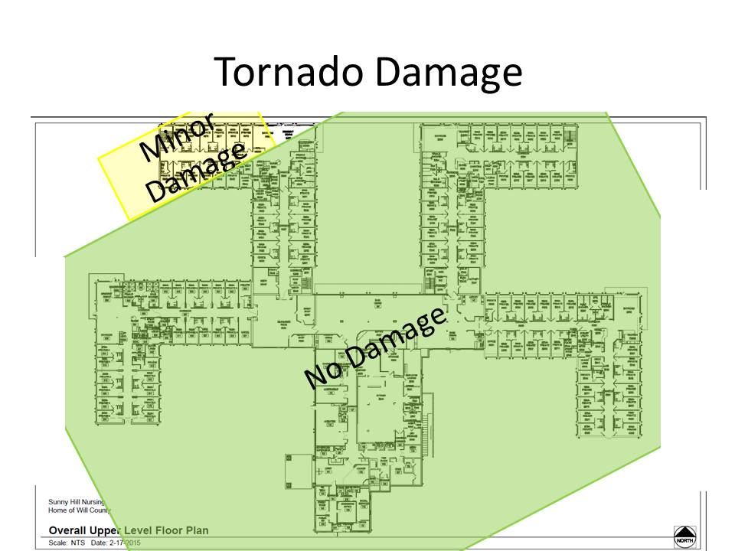
Damage

Slide 21
Module 5 Questions
What actions you would take?
What does your procedure say you should do at this point?
How would you attend to all the residence?
How long will it take for Emergency Responders to arrive?
Who contacts 911?
What is your communication plan?

Slide 22
CMC Communication Plan Requirements
Names & Contact info for:
Staff
Entities providing services under arrangements
Residents’ physicians
Other Long Term Care Facilities
Volunteers
Contact info for:
Emergency Preparedness staff
State Licensing and Certification Agency
Office of the State Long-Term Care Ombudsman
Other sources of assistance

Slide 23
CMS Regs – Part 2
Primary and alternate means for communicating with:
Sunny Hill Staff
Emergency Management agencies
A method of sharing into and medical docs for your residents with other health care providers to maintain continuity of care.
A means, in event of an evacuation, to re4lease resident info.
A means of providing info about the general condition and location of residents under Sunny Hill’s care.
A means of providing info about Sunny Hill’s occupancy, needs, and its ability to provide assistance to Incident Commander.
A method for sharing info from the emergency plan that the facility has determined is appropriate with residents and their families.

Slide 24
Module 6 Now What?
September 6, 3:03 PM
The Tornado just missed the facility.
Residents are screaming and frightened.
The wind and rain seems to have stopped instantly.
Someone looks outside and sees destruction North of your facility.

Slide 25
Module 6 Questions
How do you communicate with:
Residence
Staff members
Emergency Responders
How long will it take for Emergency Responders to arrive?
Do you think cell phones will work?
What do you do with your residents?
How will you shelter and feed residents?
Will you evacuate residents?
To where?
How?
How will you feed residents?

Slide 26
Hot Wash/Critique
List things you did well
What needs improvement

Slide 27
Evaluation Sheets
Everyone needs to fill out an evaluation sheet
Evaluation sheets are Important to help Sunny Hills to improve

Slide 28
Closing Comments

Slide 29
Thanks for your Participation

