Slide 1
Hospice Full Scale Exercise
Insert Date here

Slide 2
Why are we here?
Regulation 42cfr418 applies to Medicare & Medicaid participating providers
Emergency Care: states:
Emergency Preparedness & Procedure Initial Training
Provide Emergency Preparedness Training Annual
Conduct an exercise annually
Full scale exercise
Can conduct a second exercise in that year
Full Scale or Tabletop

Slide 3
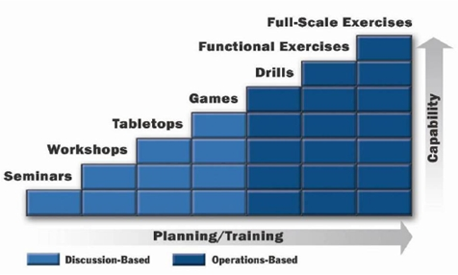
Normally
Typically, 3-5 yrs before first Full Scale exercise
Normal Progression:
Training seminars
3-4 Tabletop exercise
Functional exercise
Full Scale exercise

Slide 4
What you should expect
We will present you with a scenario
You conduct yourself as you would during the real thing
Hold discussions
Refer to procedures
Make phone calls
Ask questions of Management

Slide 5
What you should expect (Cont)
Evaluators will be documenting what you are doing
Don't be nervous, we write all kinds of stuff on our paperwork
Just because we write something it doesn't mean it is bad.
We need to document you have met the evaluation criteria
You are not allowed to ask an evaluator a question. Questions should be directed to your management
Evaluators are not mind readers. If you think appropriate, explain to them what you are thinking or what your logic is for an action

Slide 6
Evaluation
You do not receive a grade for your actions
It is NOT Pass/Fail
We are looking at:
How well you follow your procedures
How effective are your procedures
Area that might need improvement

Slide 7
Today's exercise rules
There is some artificiality in the exercise
You will be asked to make phone calls during the exercise
Because of the nature of your work, we DO wish you contact real patients to demonstrate you can actually contact them in an emergency
However, once you contact a real patient, the details of the exercise will be suspended.
You should NOT discuss that an exercise is in progress.
Cathy wishes you to hold a brief conversation with them to verify all the phone numbers on your file are correct and to ask them if they are need of anything.

Slide 8
Today's exercise rules (Cont)
Several people will be given a paper with a special phone numbers to make calls which will be staffed by our staff. These will be simulated patient.
When you call these people, we DO want you to discuss the exercise details.
Begin the conversation as follows, " Mr. Smith, this is an exercise, I am calling to.......(tell them what you would really say if this were a real situation). At the conclusion of the phone conversation, end it with "This is an exercise"
To demonstrate that hospice has the capability to provide immediate medical supplies to a patient during the emergency situation, one of our "simulated patients" will be in need. Follow your normal process during an emergency to contact your medical supply provider and have them actually deliver our "simulated medical supplies" to an address we will provide.

Slide 9
Questions

Slide 10
10 Minute Break

Slide 11
Begin the Exercise

Slide 12
Documentation
Please sign the attendance Sheet
Regulation requires documentation

Slide 13
Chicago Area, July 11-17, 1995

Slide 14
Heat Impact
Video curtesy of Press TV

Slide 15
Chicago Area, July 13, 1995
Midway Airport
106F
126F Heat Index
Nighttime temps 80s with high humidity
Power outage resulted in loss of individual’s A/C
Results
739 Heat Related Deaths

Slide 16
We’re Havin’ a Heat Wave
This years temperatures
Very High Humidity, Nighttime dew points > 80F
July 11 90F 73F
July 12 98F 76F
July 13 106F 81F
July 14 102F 84F
July 15 99F 77F
July 16 94F 76F
July 17 89F 73F

Slide 17
The exercise begins
Respond as you would in a real emergency
Keep in mind our instructions
Use your policies and procedures

